Slide 1

WELCOME
TO
INDIA Pvt. Ltd
(PROJECTS DIVISION)
Plot # 8, Lepakshi colony, West Marredpally, Secunderabad -500026
Tel: 040-27807145 / 040-65198519, Mob: +91-9951951144
E-mail: projects@greentekindia.co.in, www.greentekindia.co.in

Slide 2

ABOUT GREENTEK INDIA Pvt. Ltd.

Slide 3
MNRE – CHANNEL PARTNER

Slide 4





CERTIFICATIONS

Slide 5
MANUFACTURING FACILITY
SOLAR PV MODULES – POLY CRYSTALLINE.
SOLAR PV MODULES – MONO CRYSTALLINE.
SOLAR WATER HEATERS.
SOLAR LED STREET LIGHTS.
SOLAR FENCING.

Slide 6
SERVICES
Mega watt scale ground mounted grid tied solar PV power plants.
Large scale roof top solar PV plants for Hospitals, Hotels, Educational Institutions and other commercial buildings.
Roof top Solar PV plants under net metering / Gross metering policies.
Solar Water Heaters and large scale Solar Thermal projects.
Solar powered LED street lights.
All types of LED lights (Indoor / Outdoor)

Slide 7
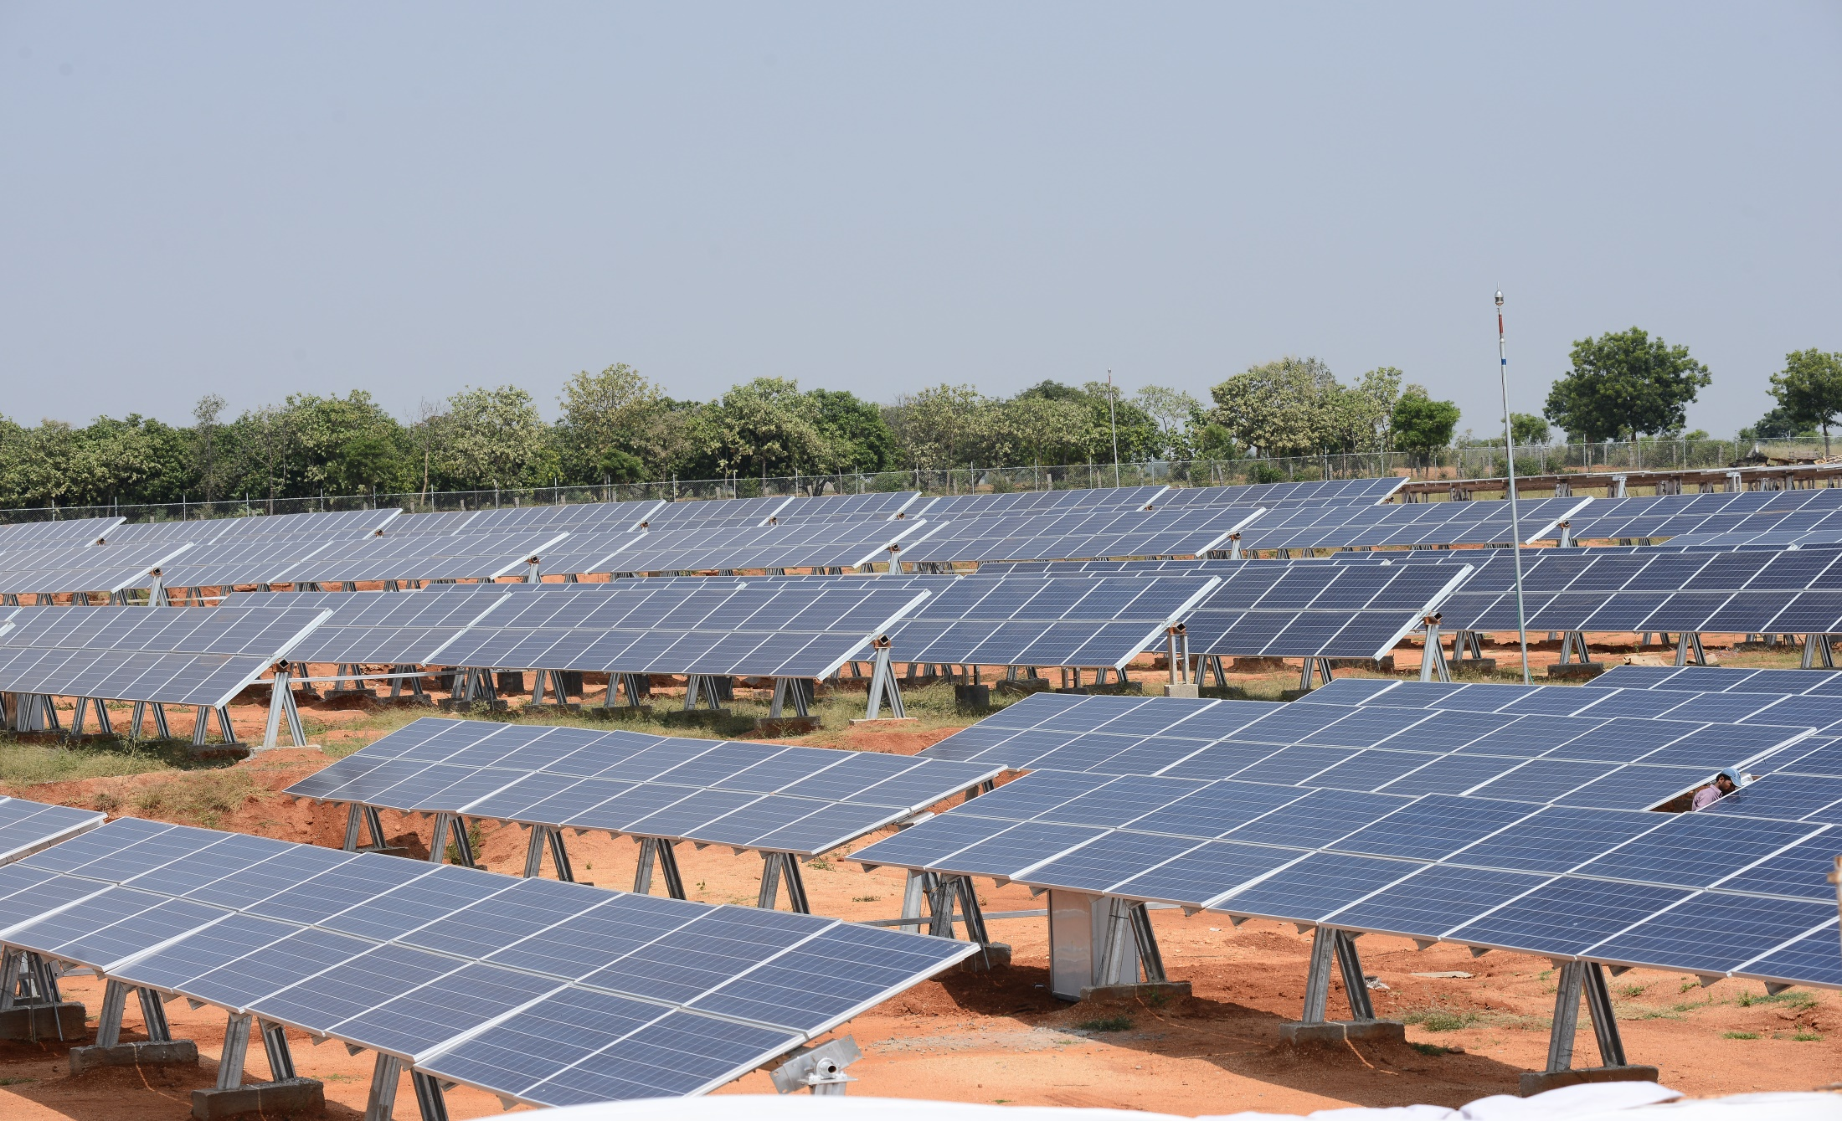
4 MW Solar PV Plant, Kalwakurthy

Slide 8
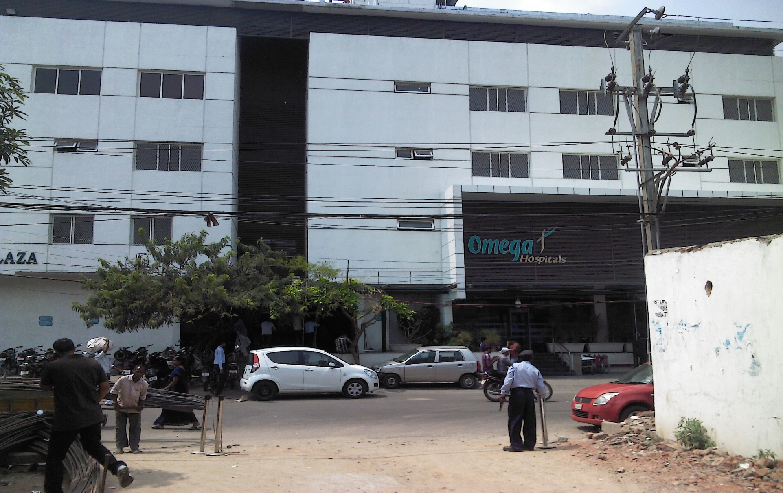
81 KW – OMEGA HOSPITAL

Slide 9
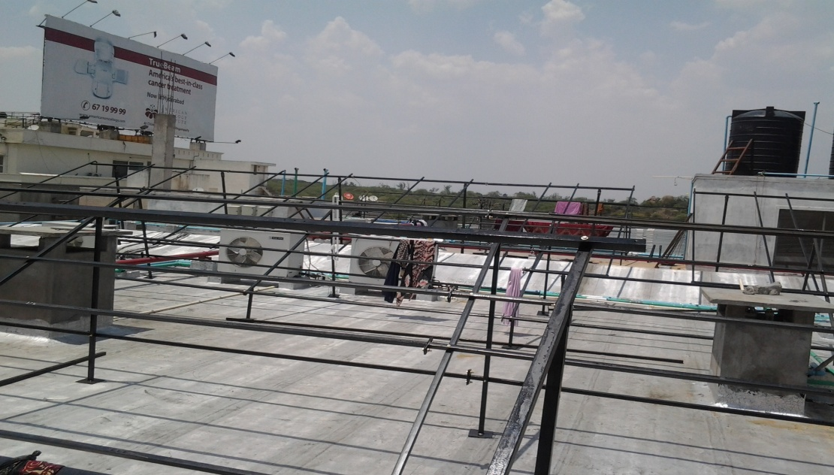
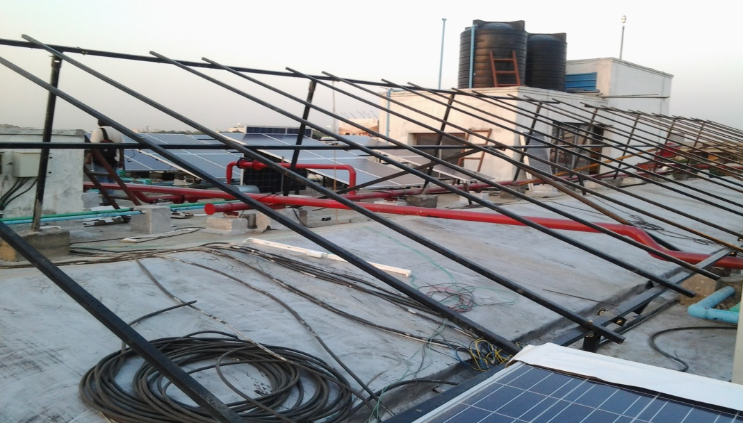
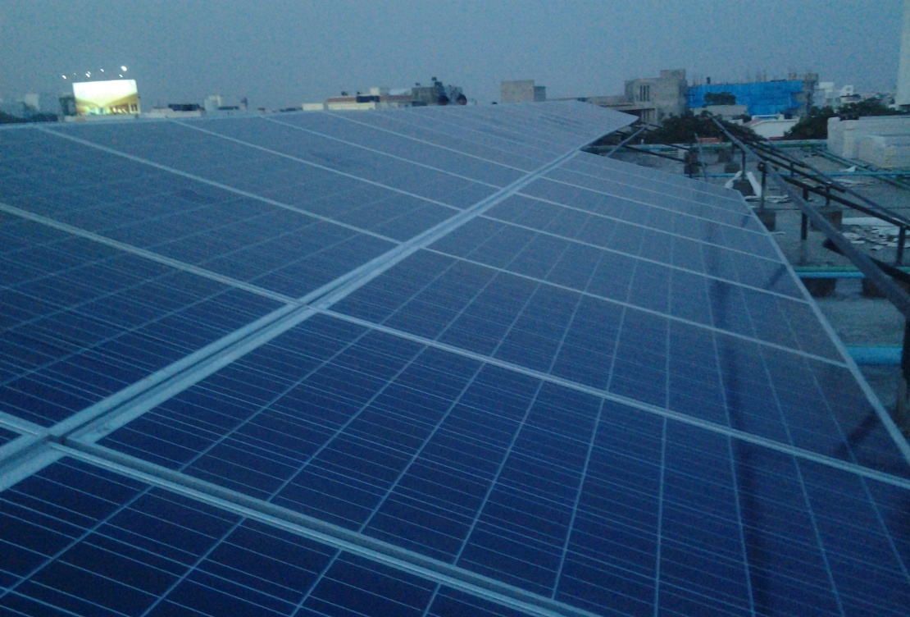
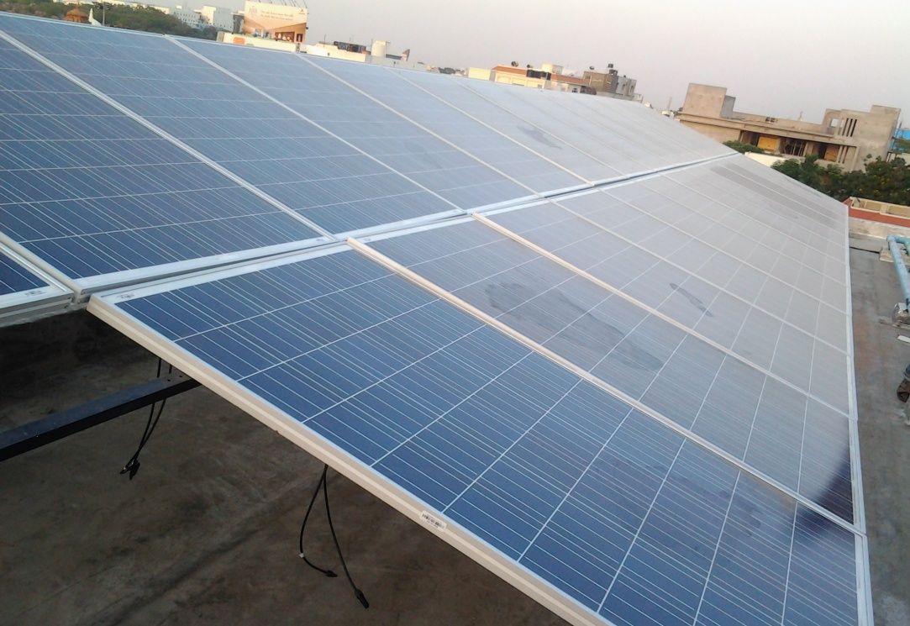
81 KW – OMEGA HOSPITAL

Slide 10
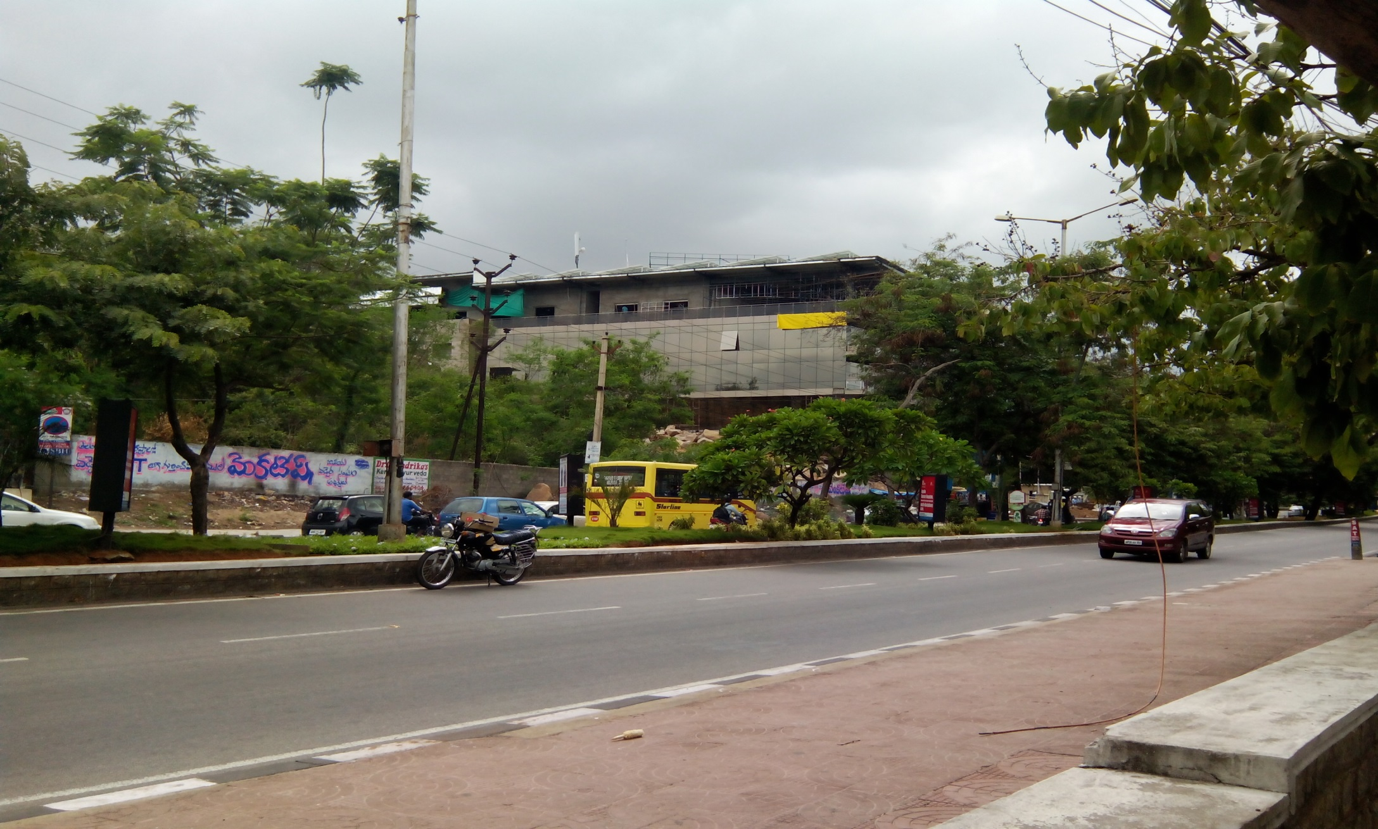
75 KW – DESHAW INDIA – GRID TIED - NETMETERING

Slide 11
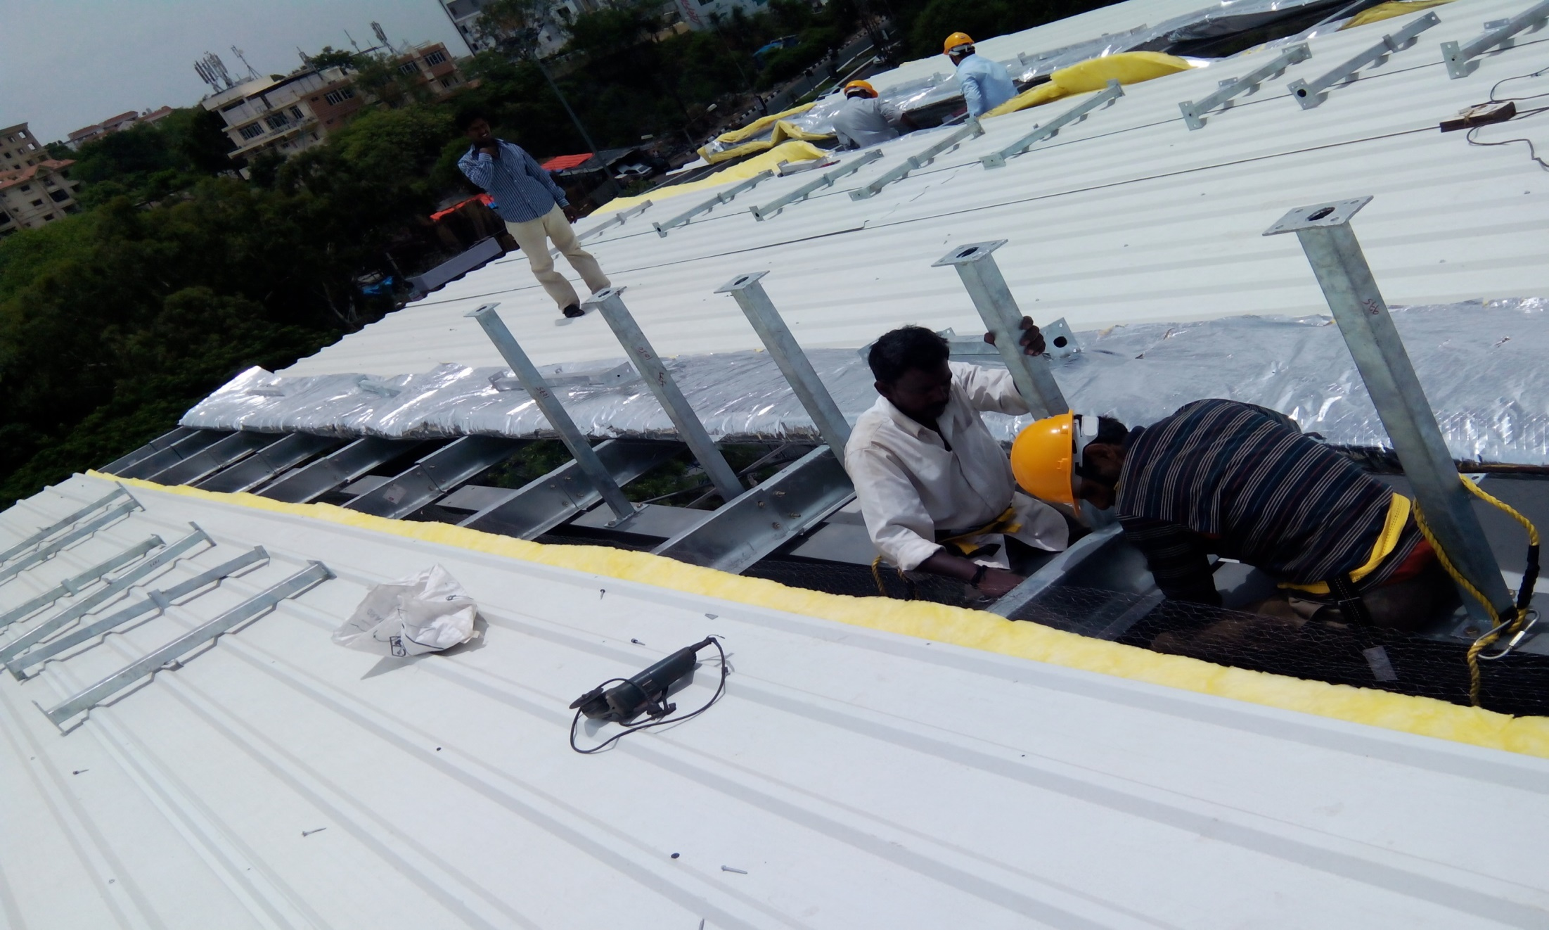
75 KW – DESHAW INDIA – GRID TIED - NETMETERING

Slide 12
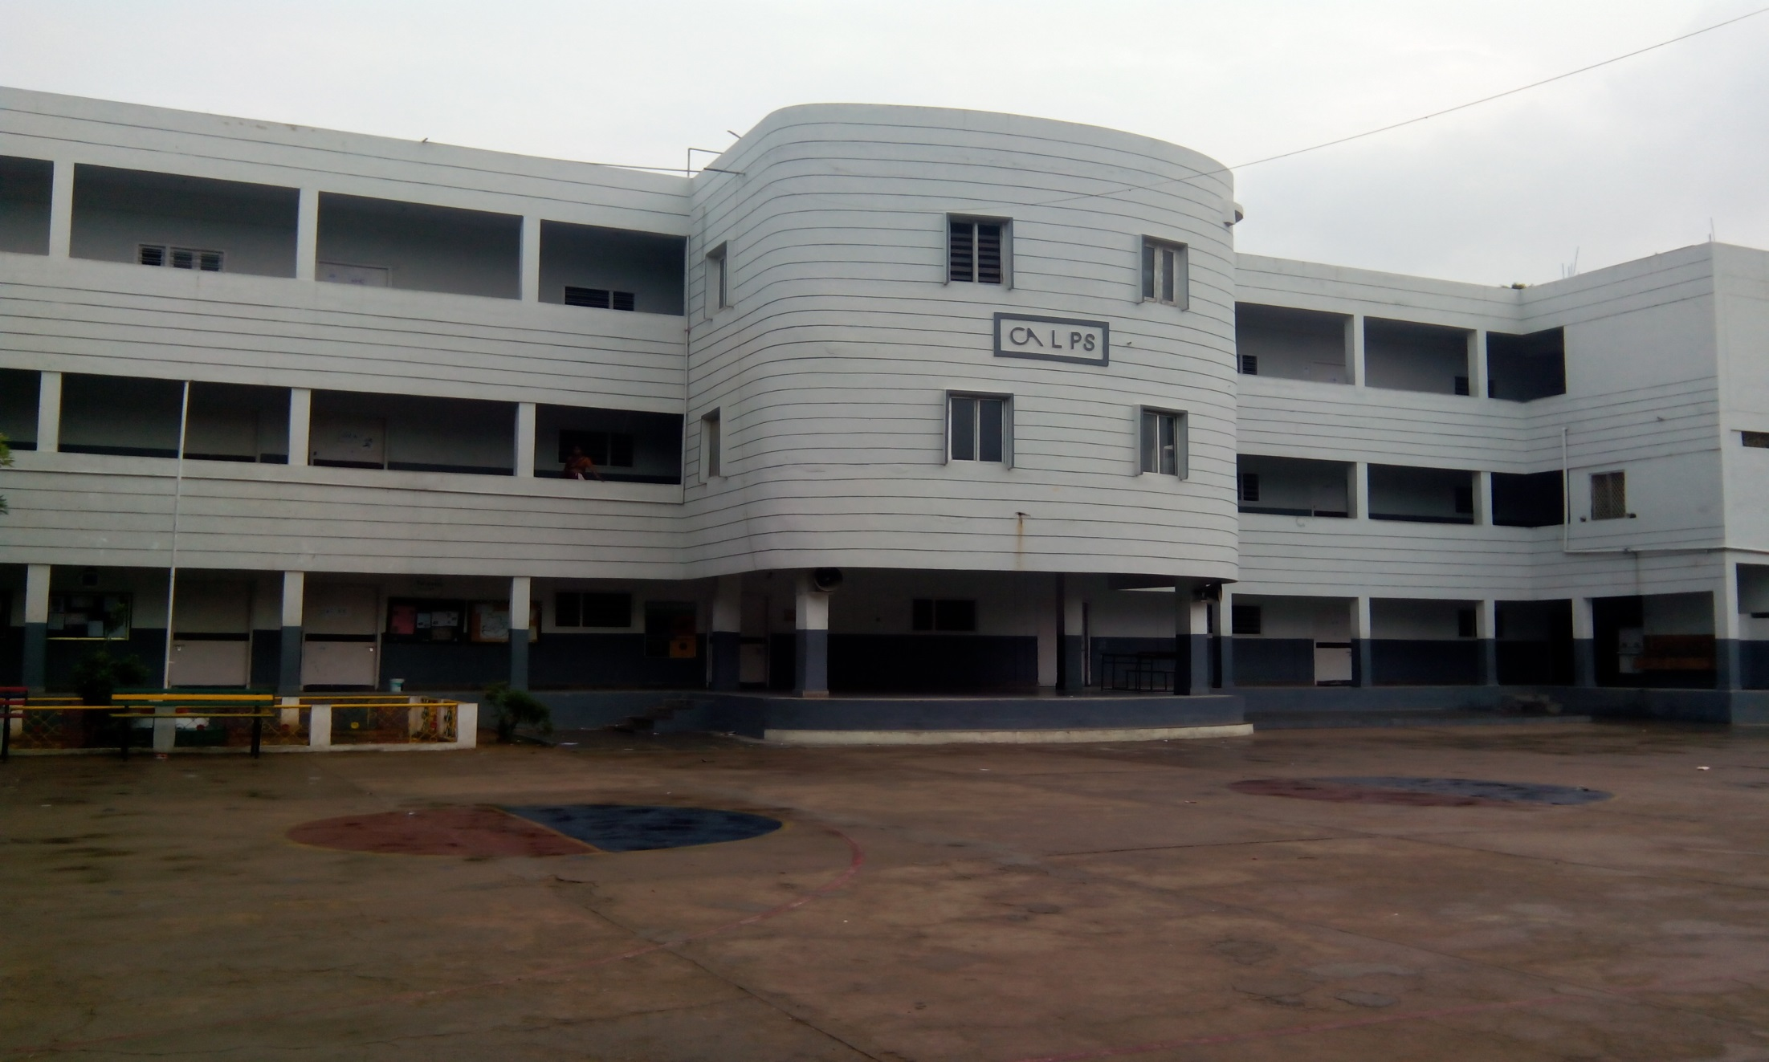
CAL PUBLIC SCHOOL – GRID TIED - NETMETERING

Slide 13
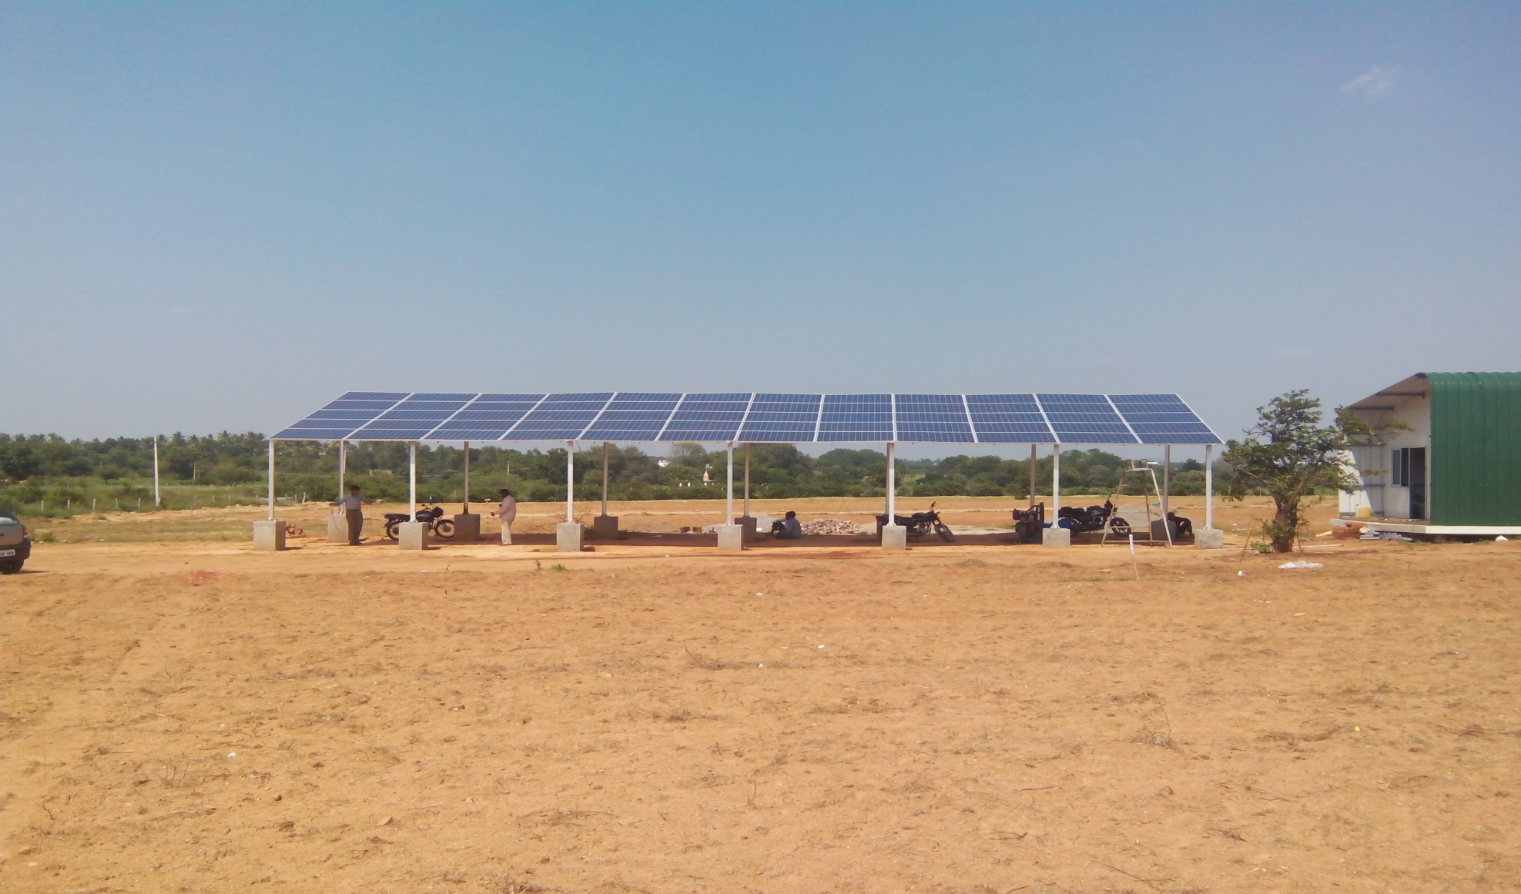
FHD GROUP – NAVIRA PROJECT HYDERABAD

Slide 14
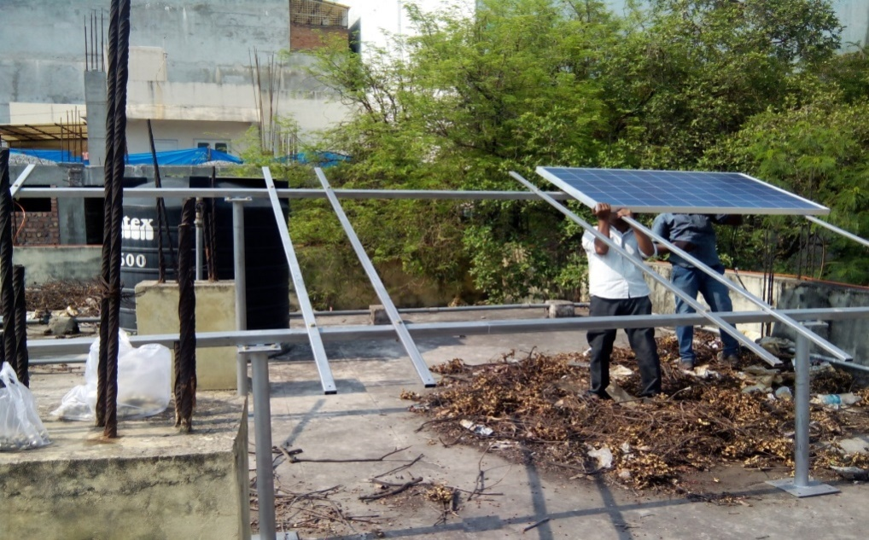
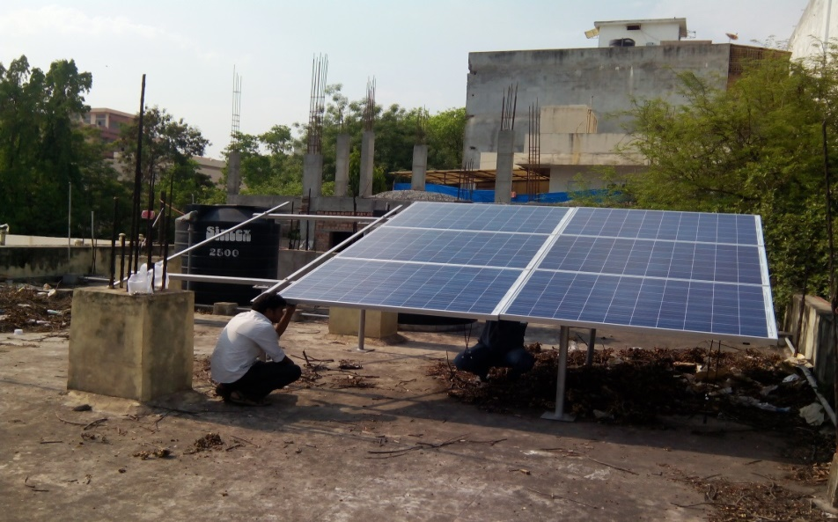
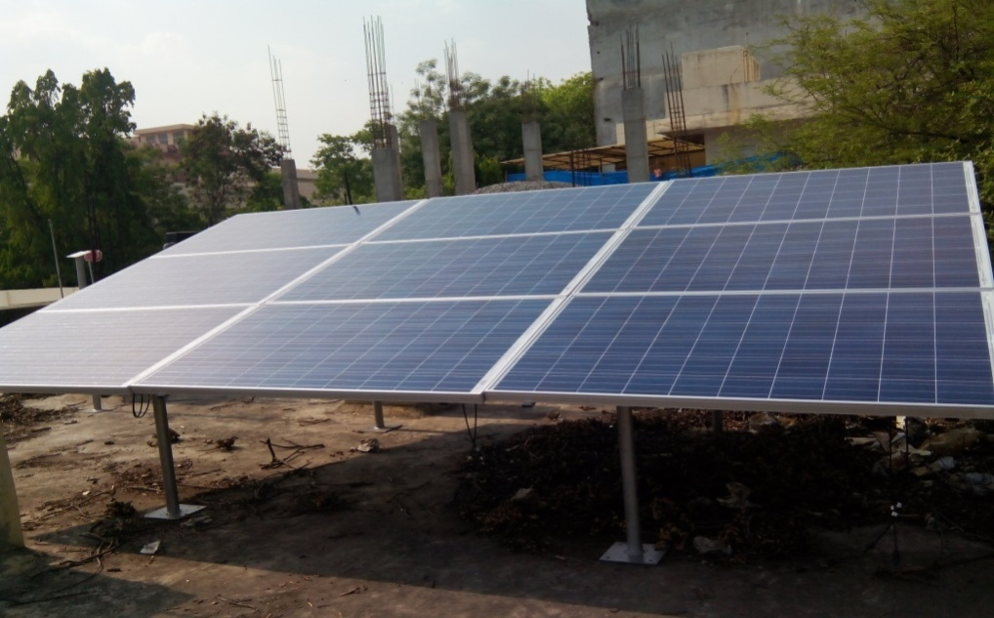
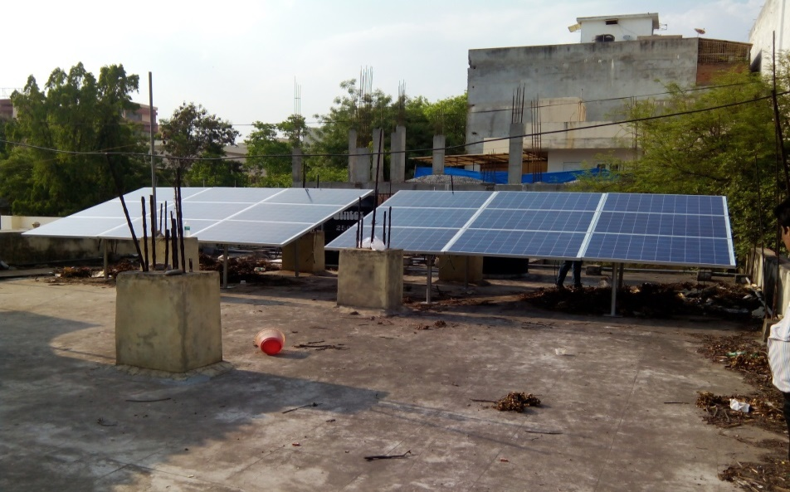
COMMISSIONER OF INDUSTRIES TSIIC – HYDERABAD.

Slide 15
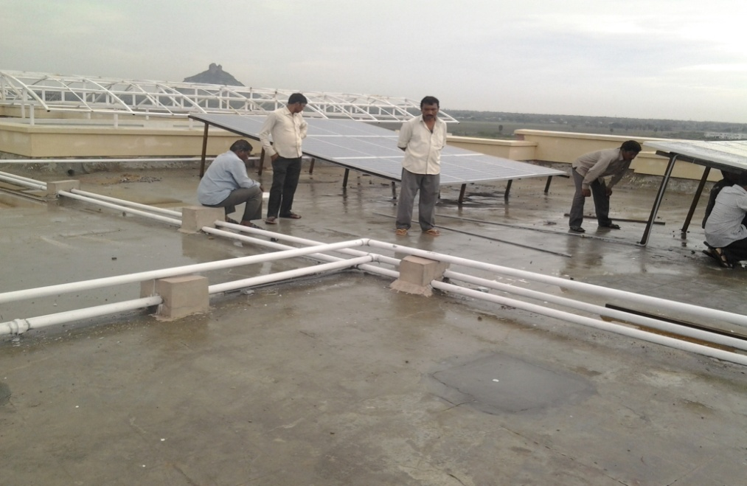
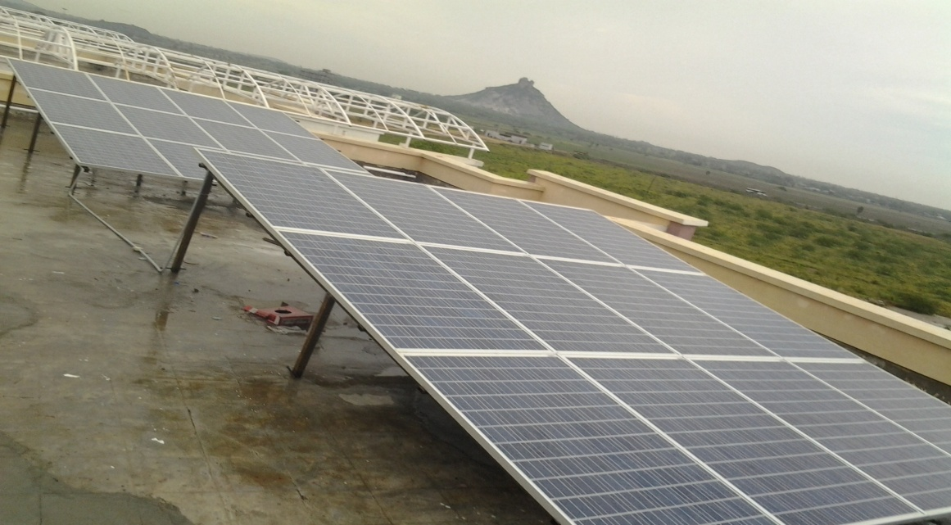
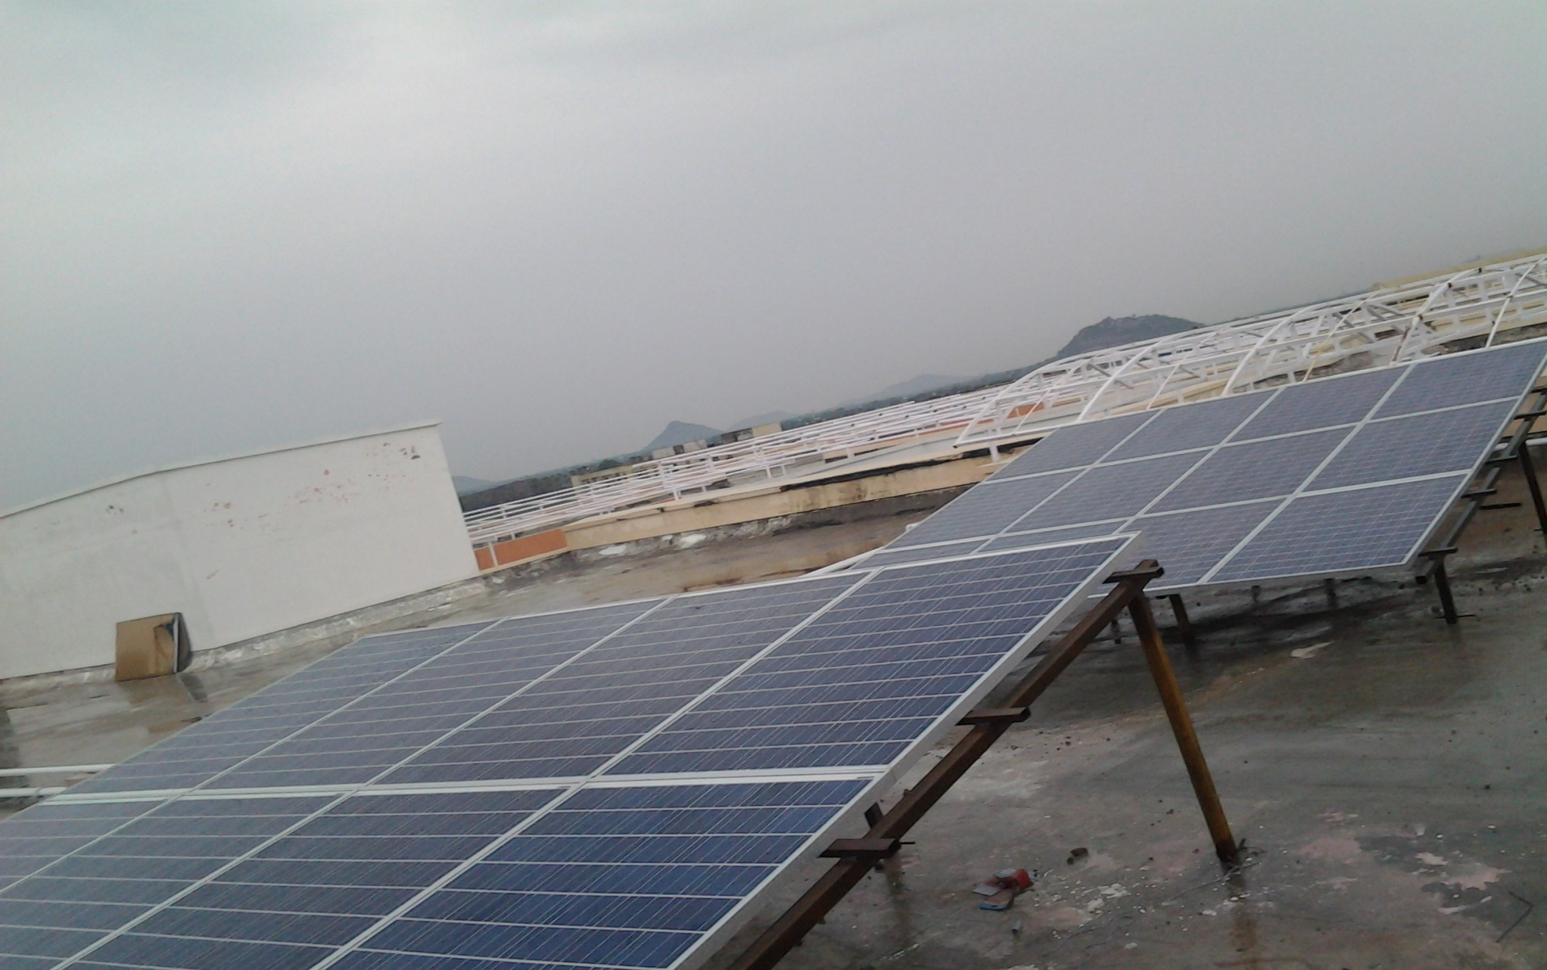
MAHATHMA GANDHI UNIVERSITY, NALGONDA.

Slide 16
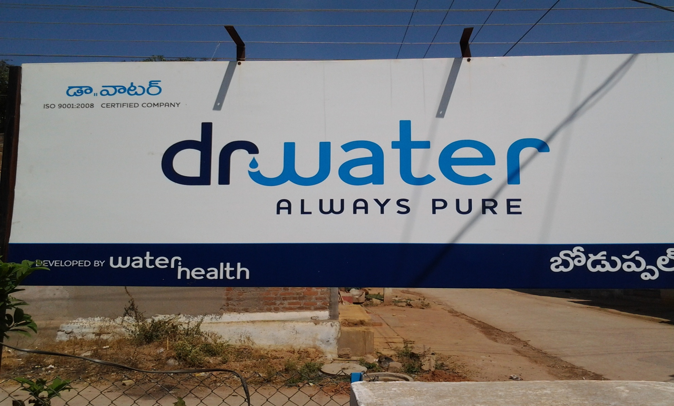
WATER HEALTH – Dr. WATER – MINERAL WATER PLANT - HYDERABAD

Slide 17
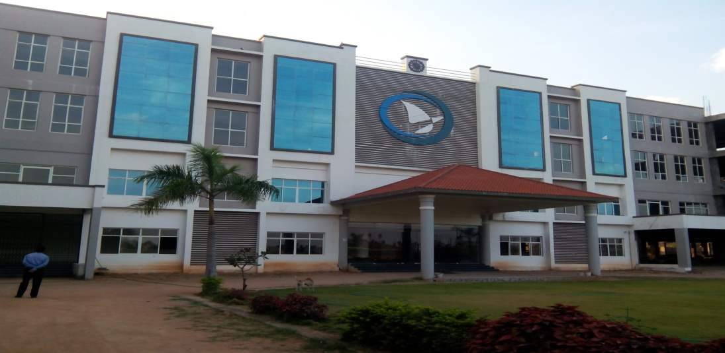
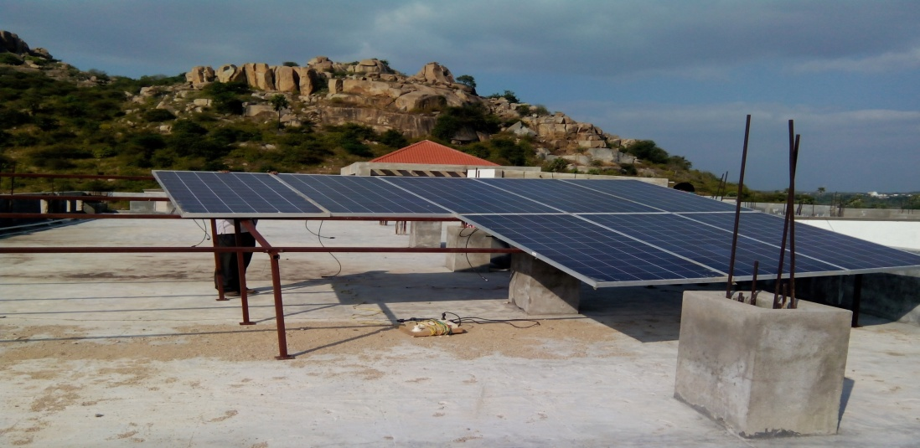
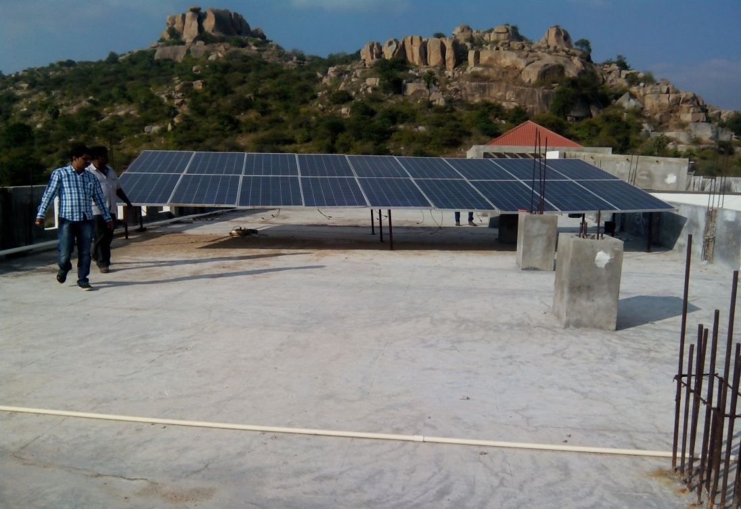
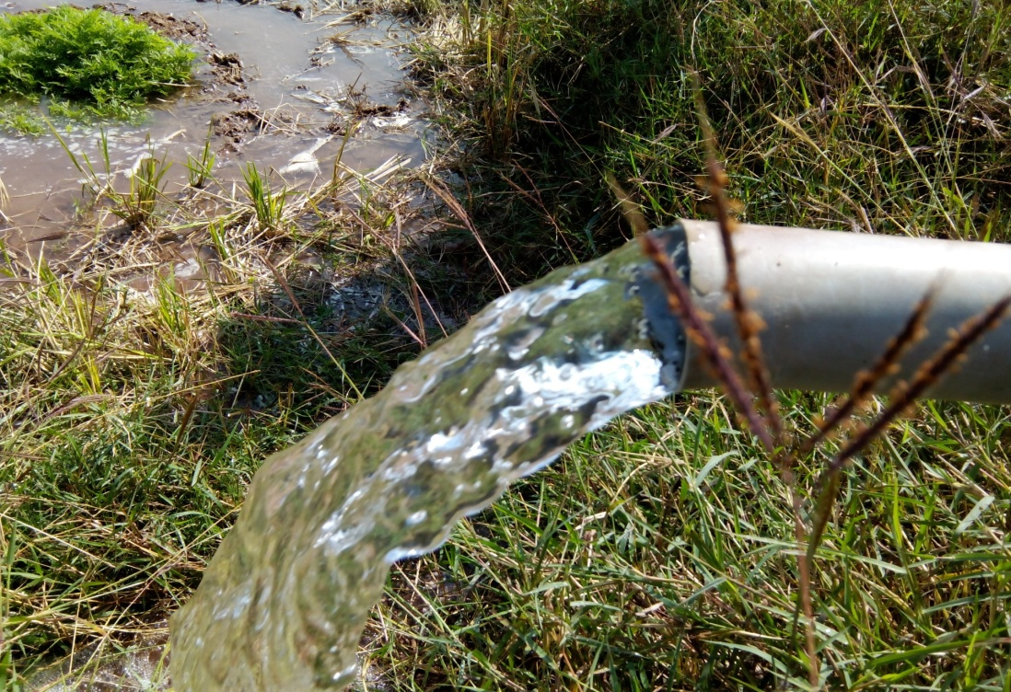
5X2 KW – KPRIT – 5 Hp MOTORS

Slide 18
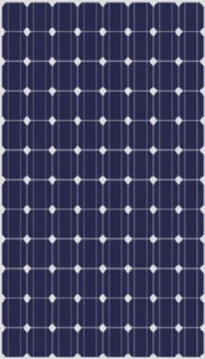
SOLAR PV MODULES
GREENTEK
Warranty – 25 years
Module efficiency ~17%
Pmax - >300Wp(DC)
Poly / Mono - crystalline
Class A type modules
These modules were used in all our projects.

Slide 19
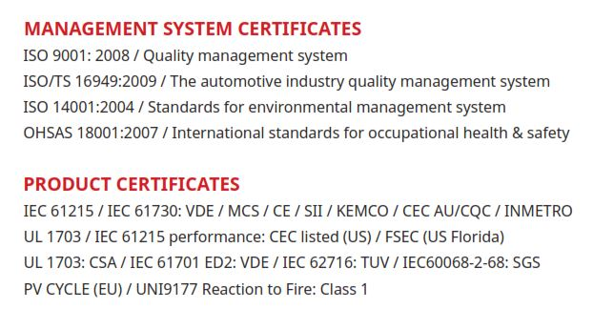
QUALITY & CERTIFICATION’S

Slide 20
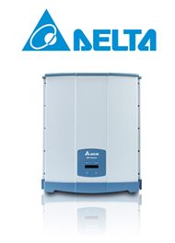
SOLAR INVERTER
Delta
String type inverter
Double tracking MPPT’s
Transformer less
5 years warranty
Efficiency ~ 99%

Slide 21
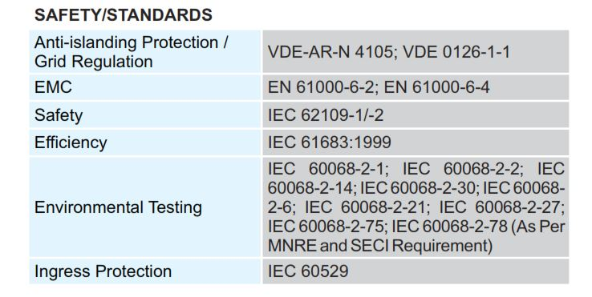
QUALITY & CERTIFICATIONS

Slide 22
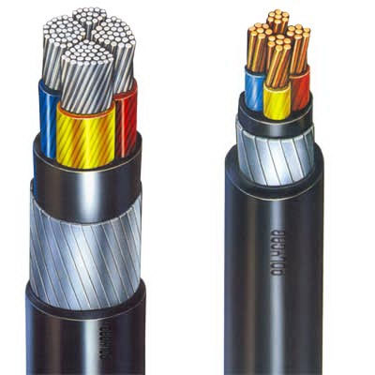
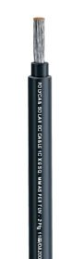
CABLE’S
Polycab
UV Resistant
Type 1 cable
ISO 9001:2008 and 14001:2004 certified
Flame Retardant Low Smoke
High temperature resistant
(Up to 120⁰C)

Slide 23
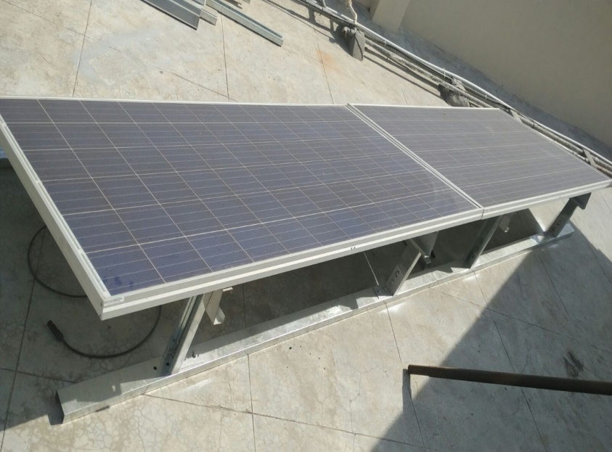
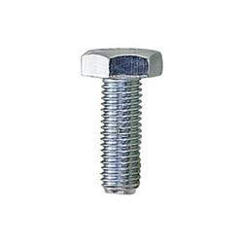
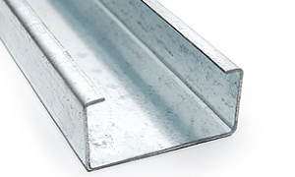
MODULE MOUNTING STRUCTURES
Galvanized iron (120 GSM)
Yield strength 245 Mpa
Designed to withstand upto160Km/hr wind speed.
Corrosion resistance
Fasteners
Stainless steel bolts for module &
Zinc plated Mild Steel bolts
for structure
SS BOLTS
LIPPED C CHANNEL

Slide 24
PROJECTS IN PROGRESS
30 MW for Aurobindo Pharma, Vishakapatanam.
10 MW for Winsol Green Power Pvt. Ltd., Mahaboobnagar.
2 MW for PSR Prime Towers, Hyderabad.
1 MW for Heemankshi Bakers Pvt. Ltd., Hyderabad.

Slide 25

Dr. N.V. Vijayaprasad
M.Sc., M.Phil., Ph.D
GM (PROJECTS – R&D)

